Slide 1
Problem solving by Search
Search: Searching is a step by step procedure to solve a search-problem in a given search space. A search problem can have three main factors:
  Search Space: Search space represents a set of possible solutions, which a system may have.
  Start State: It is a state from where agent begins the search.
  Goal test: It is a function which observe the current state and returns whether the goal state is achieved or not.
Search tree: A tree representation of search problem is called Search tree. The root of the search tree is the root node which is corresponding to the initial state.
Actions: It gives the description of all the available actions to the agent.
Transition model: A description of what each action do, can be represented as a transition model.
Path Cost: It is a function which assigns a numeric cost to each path.
Solution: It is an action sequence which leads from the start node to the goal node.
Optimal Solution: If a solution has the Best cost among all solutions.

Slide 2
Criteria of Evaluating a search
Completeness: A search algorithm is said to be complete if it guarantees to return a solution if at least any solution exists for any random input.
Optimality: If a solution found for an algorithm is guaranteed to be the best solution (lowest path cost) among all other solutions, then such a solution for is said to be an optimal solution.
Time Complexity: Time complexity is a measure of time for an algorithm to complete its task.
Space Complexity: It is the maximum storage space required at any point during the search, as the complexity of the problem.
Time and space complexity is measured in terms of b, d, ℓ and m

Slide 3
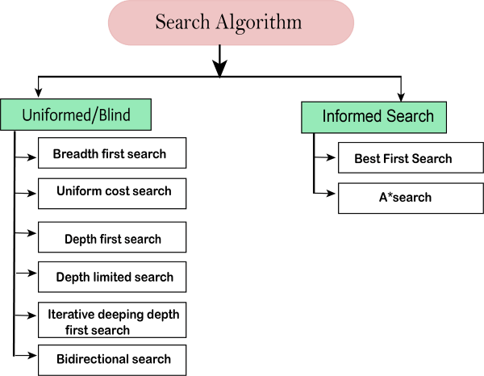
Types of Search

Slide 4
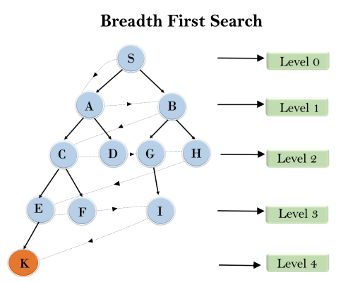
Breadth First Search
Breadth-first search implemented using FIFO queue data structure.
Does breadthwise search Level by level
Order: S---> A--->B---->C--->D---->G--->H--->E---->F---->I---->K
Completeness? – Yes only if b, d is finite
Optimal –NO
Time complexity=> T (b) = 1+b²+b³+.......+ b^{d} = O (b^{d})
Space complexity=> O(b^{d}).

Slide 5
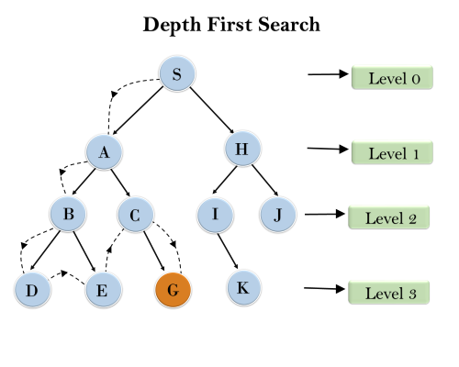
Depth First Search
It starts from the root node and follows each path to its greatest depth node before moving to the next path.
DFS uses a stack data structure for its implementation.
Root node--->Left node ----> right node.
Order=> S, A, B, D ,E, E, C, G
Completeness: YES, On if m is not Infinity.
Optimality : NO
Time complexity: T(n)= 1+ n²+ n³ +.........+ n^{m}=O(n^{m})
Space complexity: O(bm) (stores only single path from the root node, )

Slide 6
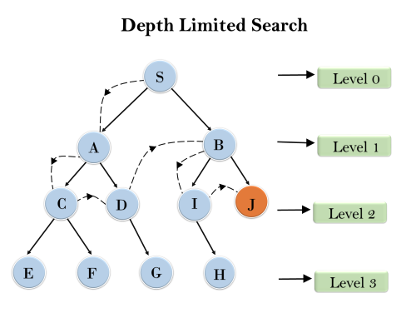
Depth-Limited Search
A depth-limited search algorithm is similar to depth-first search with a predetermined depth limit (cut off) .
Completeness: if the solution is above the depth-limit. d<ℓ
Time Complexity: O(b^{ℓ}).
Space Complexity: O(b×ℓ).
Optimal: Depth-limited search can be viewed as a special case of DFS, and it is also not optimal when if ℓ>d.

Slide 7
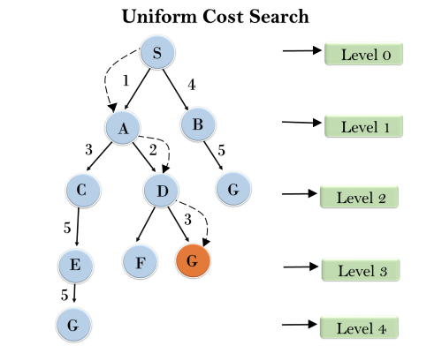
Uniform cost search
Uniform-cost search is a searching algorithm used for traversing a weighted tree or graph. This algorithm comes into play when a different cost is available for each edge. The primary goal of the uniform-cost search is to find a path to the goal node which has the lowest cumulative cost.

Slide 8
Uniform Cost Search evaluation
Completeness:
Uniform-cost search is complete. UCS will find it, if there exists one
Time Complexity:
Let C* is Cost of the optimal solution, and ε is each step to get closer to the goal node. Then the number of steps is = C*/ε+1. Here we have taken +1, as we start from state 0 and end to C*/ε.
Hence, the worst-case time complexity of Uniform-cost search isO(b^{1 + [C*/ε]})/.
Space Complexity:
The same logic is for space complexity so, the worst-case space complexity of Uniform-cost search is O(b^{1 + [C*/ε]}).
Optimal:
Uniform-cost search is always optimal as it only selects a path with the lowest path cost.

Slide 9
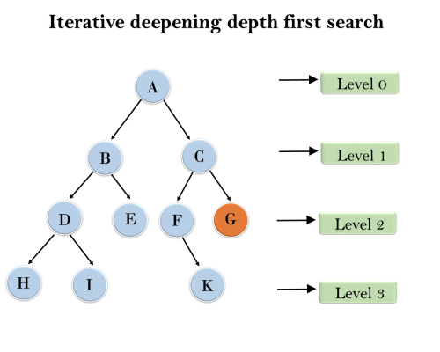
Iterative deepening depth-first Search
The iterative deepening algorithm is a combination of DFS and BFS algorithms. This search algorithm finds out the best depth limit and does it by gradually increasing the limit until a goal is found.
This Search algorithm combines the benefits of Breadth-first search's fast search and depth-first search's memory efficiency.
1'st Iteration-----> A
2'nd Iteration----> A, B, C
3'rd Iteration------>A, B, D, E, C, F, G
4'th Iteration------>A, B, D, H, I, E, C, F, K, G
In the fourth iteration, the algorithm will find the goal node.

Slide 10
IDIDS Evaluation
Completeness:
This algorithm is complete is If the branching factor is finite.
Time Complexity:
Let's suppose b is the branching factor and depth is d then the worst-case time complexity is O(b^{d}).
Space Complexity:
The space complexity of IDDFS will be O(bd).
Optimal:
IDDFS algorithm is optimal if path cost is a non- decreasing function of the depth of the node.

Slide 11
Bidirectional search
Bidirectional search algorithm runs two simultaneous searches, one form initial state called as forward-search and other from goal node called as backward-search, to find the goal node.
This algorithm divides one graph/tree into two sub-graphs. It starts traversing from node 1 in the forward direction and starts from goal node 16 in the backward direction.

Slide 12
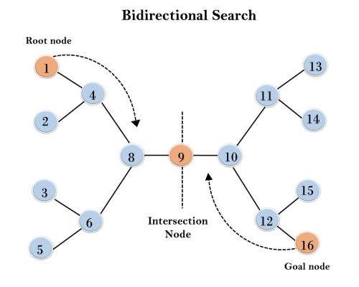

Slide 13
BDS Evaluation
Completeness: Bidirectional Search is complete if we use BFS in both searches.
Time Complexity: Time complexity of bidirectional search using BFS is O(b^{d}).
Space Complexity: Space complexity of bidirectional search is O(b^{d}).
Optimal: Bidirectional search is Optimal.

Slide 14
Informed Search Algorithm (heuristic search)
Informed search algorithm contains an array of knowledge such as how far we are from the goal, path cost, how to reach to goal node, etc. This knowledge help agents to explore less to the search space and find more efficiently the goal node.
The informed search algorithms are more useful for large search space
Heuristics function: Heuristic is a function which is used in Informed Search, it finds the most promising path.
It takes the current state of the agent as its input and produces the estimation of how close the agent is from the goal.
Heuristic function estimates how close a state is to the goal.
It is represented by h(n).

Slide 15
h(n) admissibility
Admissibility of the heuristic function is given as:
h(n) <= h*(n)
h(n) is heuristic cost, and h*(n) is the estimated cost.
examples
Best First Search Algorithm(Greedy search)
A* Search Algorithm (Greedy search)

Slide 16
Pure Heuristic Search:
It expands nodes based on their heuristic value h(n).
It maintains two lists,
OPEN list (it places nodes which have not yet been expanded)
CLOSED list. (places those nodes which have already been expanded )
In each iteration, each node n with the lowest heuristic value is expanded and generates all its successors and n is placed to the closed list. The algorithm continues until a goal state is established.

Slide 17
Greedy Best-first Search
Greedy best-first search algorithm always selects the path which appears best at that moment. It is the combination of depth-first search and breadth-first search algorithms
With the help of best-first search, at each step, we can choose the most promising node.
It expands the node that is estimated to be closest to goal. It expands nodes based
on f(n) = h(n).
Where,
F(n) = evaluation function
h(n)= estimated cost from node n to the goal.
It is implemented using priority queue.

Slide 18
Best first search algorithm:
Step 1: Place the starting node into the OPEN list.
Step 2: If the OPEN list is empty, Stop and return failure.
Step 3: Remove the node n, from the OPEN list which has the lowest value of h(n), and places it in the CLOSED list.
Step 4: Expand the node n, and generate the successors of node n.
Step 5: Check each successor of node n, and find whether any node is a goal node or not. If any successor node is goal node, then return success and terminate the search, else proceed to Step 6.
Step 6: For each successor node, algorithm checks for evaluation function f(n), and then check if the node has been in either OPEN or CLOSED list. If the node has not been in both list, then add it to the OPEN list.
Step 7: Return to Step 2.

Slide 19
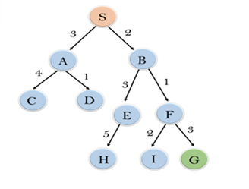
Example
Consider the search problem below, We will traverse it using greedy best-first search.
At each iteration, each node is expanded using evaluation function f(n)=h(n)

Slide 20
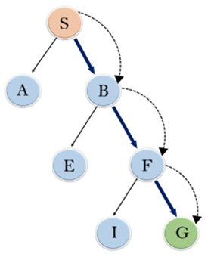
In this search example, we are using two lists which are OPEN and CLOSED Lists
Expand the nodes of S and put in the CLOSED list
Initialization: Open [A, B], Closed [S]
Iteration 1: Open [A], Closed [S, B]
Iteration 2: Open [E, F, A], Closed [S, B]
: Open [E, A], Closed [S, B, F]
Iteration 3: Open [I, G, E, A], Closed [S, B, F]
: Open [I, E, A], Closed [S, B, F, G]
Final solution path will be: S----> B----->F----> G

Slide 21
Evaluation
Time Complexity: The worst case time complexity of Greedy best first search is O(b^{m}).
Space Complexity: The worst case space complexity of Greedy best first search is O(b^{m}). Where, m is the maximum depth of the search space.
Complete: Greedy best-first search is also incomplete, even if the given state space is finite.
Optimal: Greedy best first search algorithm is not optimal.

Slide 22
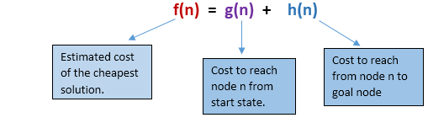
A* Search Algorithm:
It avoids expanding paths that are already expensive, but expands most promising paths first.
f(n) = g(n) + h(n), where
• g(n) the cost (so far) to reach the node
• h(n) estimated cost to get from the node to the goal
• f(n) estimated total cost of path through n to goal. It is implemented using
priority queue by increasing f(n)

Slide 23
A* search Algorithm
Step1: Place the starting node in the OPEN list.
Step 2: Check if the OPEN list is empty or not, if the list is empty then return failure and stops.
Step 3: Select the node from the OPEN list which has the smallest value of evaluation function (g+h), if node n is goal node then return success and stop, otherwise
Step 4: Expand node n and generate all of its successors, and put n into the closed list. For each successor n', check whether n' is already in the OPEN or CLOSED list, if not then compute evaluation function for n' and place into Open list.
Step 5: Else if node n' is already in OPEN and CLOSED, then it should be attached to the back pointer which reflects the lowest g(n') value.
Step 6: Return to Step 2.

Slide 24
A star search
Disadvantages:
It does not always produce the shortest path as it mostly based on heuristics and approximation.
A* search algorithm has some complexity issues.
The main drawback of A* is memory requirement as it keeps all generated nodes in the memory, so it is not practical for various large-scale problems.
Advantages:
A* search algorithm is the best algorithm than other search algorithms.
A* search algorithm is optimal and complete.
This algorithm can solve very complex problems.

Slide 25
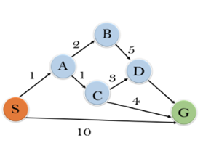
Example of A star search
In this example, we will traverse the given graph using the A* algorithm. The heuristic value of all states is given in the below table so we will calculate the f(n) of each state using the formula f(n)= g(n) + h(n), where g(n) is the cost to reach any node from start state.
Here we will use OPEN and CLOSED list.

Slide 26
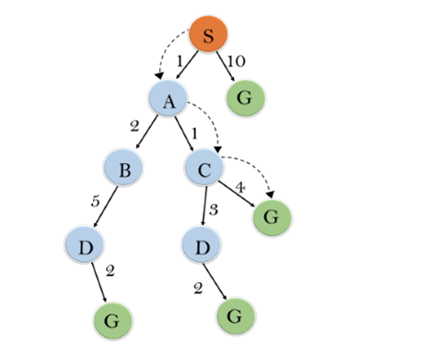
Solution
Initialization: {(S, 5)}
Iteration1: {(S--> A, 4), (S-->G, 10)}
Iteration2: {(S--> A-->C, 4), (S--> A-->B, 7), (S-->G, 10)}
Iteration3: {(S--> A-->C--->G, 6), (S--> A-->C--->D, 11), (S--> A-->B, 7), (S-->G, 10)}
Iteration 4 will give the final result, as S--->A--->C--->G it provides the optimal path with cost 6.

Slide 27
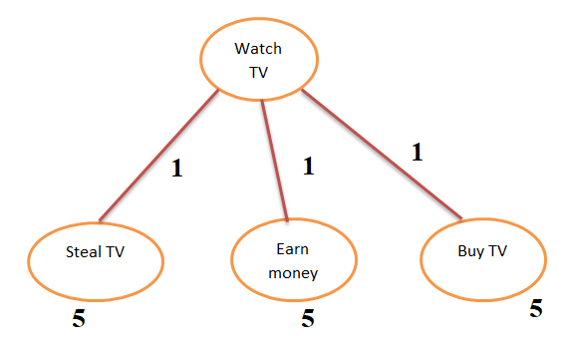
AO* search algorithm (AND OR graph)
AO* algorithm works mainly based on two phases. First phase will find a heuristic value for nodes and arcs in a particular level. It used AND OR to find the optimal path.

Slide 28
Local Search
They start from a prospective solution and then move to a neighboring solution.
Hill-Climbing Search
It is an iterative algorithm that starts with an arbitrary solution to a problem and attempts to find a better solution by changing a single element of the solution incrementally. If the change produces a better solution, an incremental change is
taken as a new solution. This process is repeated until there are no further
improvements.

Slide 29
function Hill-Climbing (problem), returns a state that is a local maximum.
inputs: problem, a problem
local variables: current, a node
neighbor, a node
current ←Make_Node(Initial-State[problem])
loop
do neighbor ← a highest_valued successor of current
if Value[neighbor] ≤ Value[current] then
return State[current]
current ← neighbor
end

Slide 30
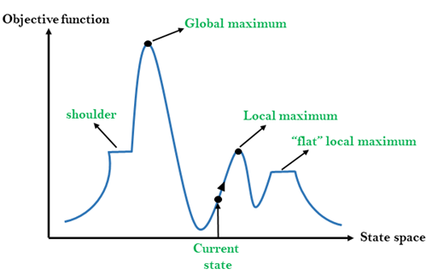
State space diagram of Hill climbing

Slide 31
Hill climbing Terms
Local Maximum: Local maximum is a state which is better than its neighbor states, but there is also another state which is higher than it.
Global Maximum: Global maximum is the best possible state of state space landscape. It has the highest value of objective function.
Current state: It is a state in a landscape diagram where an agent is currently present.
Flat local maximum: It is a flat space in the landscape where all the neighbor states of current states have the same value.
Shoulder: It is a plateau region which has an uphill edge.

Slide 32
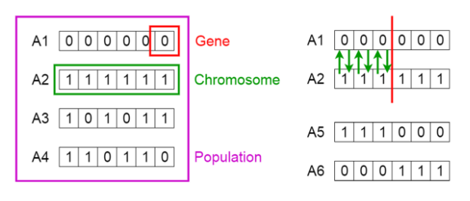
Genetic algorithms
A genetic algorithm is a search heuristic that is inspired by Charles Darwin’s theory of natural evolution. This algorithm reflects the process of natural selection where the fittest individuals are selected for reproduction in order to produce offspring of the next generation. They produce offspring which inherit the characteristics of the parents and will be added to the next generation. If parents have better fitness, their offspring will be better than parents and have a better chance at surviving

Slide 33
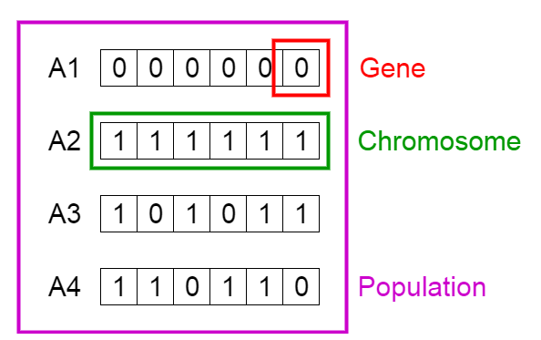
Phases Of GA
1. Initial Population
The process begins with a set of individuals which is called a Population. Each individual is a solution to the problem you want to solve.
An individual is characterized by a set of parameters (variables) known as Genes. Genes are joined into a string to form a Chromosome (solution). genes of an individual is represented using a string, in terms of an alphabet (string of 1s and 0s)
Genes are encoded in a chromosome.
Initial population
Fitness function
Selection
Crossover
Mutation

Slide 34
2. Fitness Function
The fitness function determines how fit an individual is (the ability of an individual to compete with other individuals). It gives a fitness score to each individual. The probability that an individual will be selected for reproduction is based on its fitness score.
3. Selection
The idea of selection phase is to select the fittest individuals and let them pass their genes to the next generation.
Two pairs of individuals (parents) are selected based on their fitness scores. Individuals with high fitness have more chance to be selected for reproduction.

Slide 35
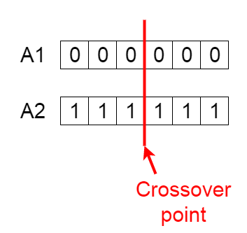
4. Crossover is the most significant phase in a genetic algorithm. For each pair of parents to be mated, a crossover point is chosen at random from within the genes.
Offspring are created by exchanging the genes of parents among themselves until the crossover point is reached.

Slide 36
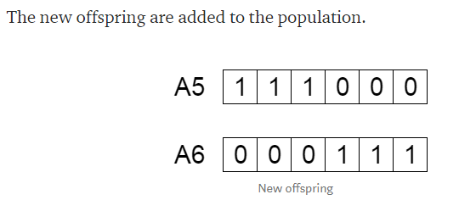

Slide 37
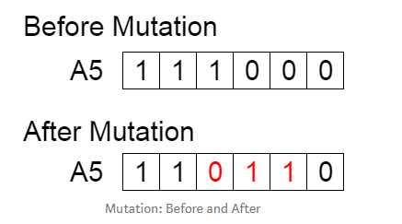
In mutation some of their genes can be subjected to a mutation with a low random probability.
This implies that some of the bits in the bit string can be flipped.
This implies that some of the bits in the bit string can be flipped.
Mutation occurs to maintain diversity within the population and prevent premature convergence (local Optimum).

Slide 38
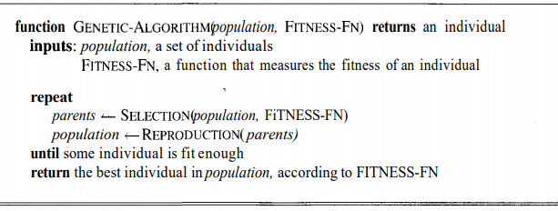
Termination
The algorithm terminates if the population has converged (does not produce offspring which are significantly different from the previous generation). Then it is said that the genetic algorithm has provided a set of solutions to our problem.

Slide 39
Application areas
Clustering to optimize a wide range of different fit-functions.
Feature selection for Machine Learning
Learning robot behavior
Image processing using Dense pixel matching
Learning fuzzy rule base
Construction of facial composites of suspects by eyewitnesses in forensic science
Data Centers
Distributed computer network topologies
Electronic circuit design

Slide 40
Adversarial Search
Adversarial search is a search, where we examine the problem which arises when we try to plan ahead of the world and other agents are planning against us.
Searches in which two or more players with conflicting goals are trying to explore the same search space for the solution, are called adversarial searches, often known as Games
 | Deterministic | Chance Moves
Perfect information | Chess, Checkers, go, Othello | Backgammon, monopoly
Imperfect information | Battleships, blind, tic-tac-toe | Bridge, poker, scrabble, nuclear war

Slide 41
REFERENCES
Artificial Intelligence: A Modern Approach Textbook by Peter Norvig and Stuart J. Russell

